Slide 1

Cybersecurity Threats in Internet of Medical Things (IoMT): Challenges and Responses in the Healthcare Sector

Slide 2

Introduction
The use of the Internet of Medical Things (IoMT) in healthcare is growing swiftly, delivering major advantages such as continuous, real-time patient monitoring and customized medical care (Alhaj et al., 2022).
This presentation examines the primary cybersecurity weaknesses within IoMT systems and evaluates how effective current defense mechanisms are.
Particular focus is given to the CIA triad — Confidentiality, Integrity, and Availability — as the core principles necessary for maintaining a secure and trustworthy IoMT environment (Brown et al., 2023).

Slide 3
Research Questions
What are the primary security threats targeting IoMT networks and devices?
To what extent are existing security mechanisms effective in mitigating IoMT-related cyber threats?
To what extent can artificial intelligence improve the cybersecurity resilience of IoMT infrastructures?

Slide 4
Methodology and Source Selection
Sources were selected from IEEE Xplore, ScienceDirect, PubMed, and SpringerLink.
Keywords: “IoMT cybersecurity,” “medical device security,” “AI in healthcare IoT.”
Timeframe: Studies and publications from 2018 to 2024.
Focus on peer-reviewed articles, technical white papers, and international cybersecurity policies.

Slide 5
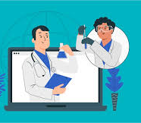
IoMT in Healthcare – An Overview
The Internet of Medical Things (IoMT) consists of key components such as sensors, communication networks, cloud infrastructures, and intelligent decision-making algorithms (Fahim-Ul-Islam et al., 2025)
It enables continuous patient monitoring, telehealth services, and data-driven treatment strategies that enhance healthcare delivery (Mushtaq et al., 2021).
The global IoMT market is expected to expand substantially, reaching an estimated value of USD 285 billion by 2029.

Slide 6
Types of IoMT Devices and Applications
Device/Application | Description
Insulin Pumps | Automatically administer insulin for real-time diabetes management.
Pacemakers | Monitor and regulate heart rhythm for cardiac patients.
Wearable ECG Monitors | Continuously monitor cardiac activity and issue alerts when abnormalities are detected.
Imaging Scanners | Digitally record and transmit imaging data such as CT and MRI scans.
Remote Patient Monitoring | Allows doctors to track patient vitals remotely and intervene early.
Cloud-Based Systems | Enable centralised diagnostics, data sharing, and resource management.

Slide 7
Key Cybersecurity Threats
Threat Type | Impact
Ransomware | Encrypts data and demands payment for access; e.g., WannaCry.
Phishing | Tricks users into revealing sensitive information via fake emails or links.
Malware | Malicious software capable of disrupting or monitoring device operations.
DDoS Attacks | Overwhelms networks or servers, leading to service outages.
Supply Chain Attacks | Targets vulnerabilities in third-party components or vendor systems.
Insider Threats | Employees or contractors who misuse access privileges to compromise systems (Bughio et al., 2024).

Slide 8
Human Factors and Legacy Systems
Many security breaches occur as a result of inadequate staff awareness regarding phishing and social engineering.
Vendors often do not coordinate timely security updates and patches, resulting in extended vulnerability to threats and weaknesses within the system.
Healthcare systems frequently depend on outdated software and unpatched firmware, which exposes them to known vulnerabilities that could be prevented through consistent maintenance.

Slide 9
Compliance and Regulatory Challenges
Regulatory Standards
Enforcement Gaps
Cross-Border Data Transfers
Regulations such as HIPAA in the United States and GDPR in the European Union are established to safeguard the confidentiality and integrity of health data within IoMT systems.
The application and enforcement of these regulations vary considerably among regions, creating compliance challenges and disparities in data protection..
Cross-border data transfers encounter legal complexities, particularly following the Schrems II ruling, which invalidated existing data-sharing frameworks and heightened regulatory scrutiny..

Slide 10
Security Solutions and AI Innovations
Security Measure | Function
Encryption | Protects data by converting it into unreadable formats for unauthorised users.
Network Segmentation | Isolates critical systems to limit the spread of cyberattacks (Mushtaq et al., 2021).
Multi-Factor Authentication | It necessitates multiple authentication steps for access, thereby enhancing login security.
Blockchain | Provides immutable, secure records for medical data storage.
AI-Based Intrusion Detection | Employs machine learning algorithms to detect and mitigate threats in real time.
Manickam (2022) | Manickam (2022) highlights the role of AI in enhancing the security and functionality of IoMT devices, particularly in point-of-care healthcare systems.

Slide 11
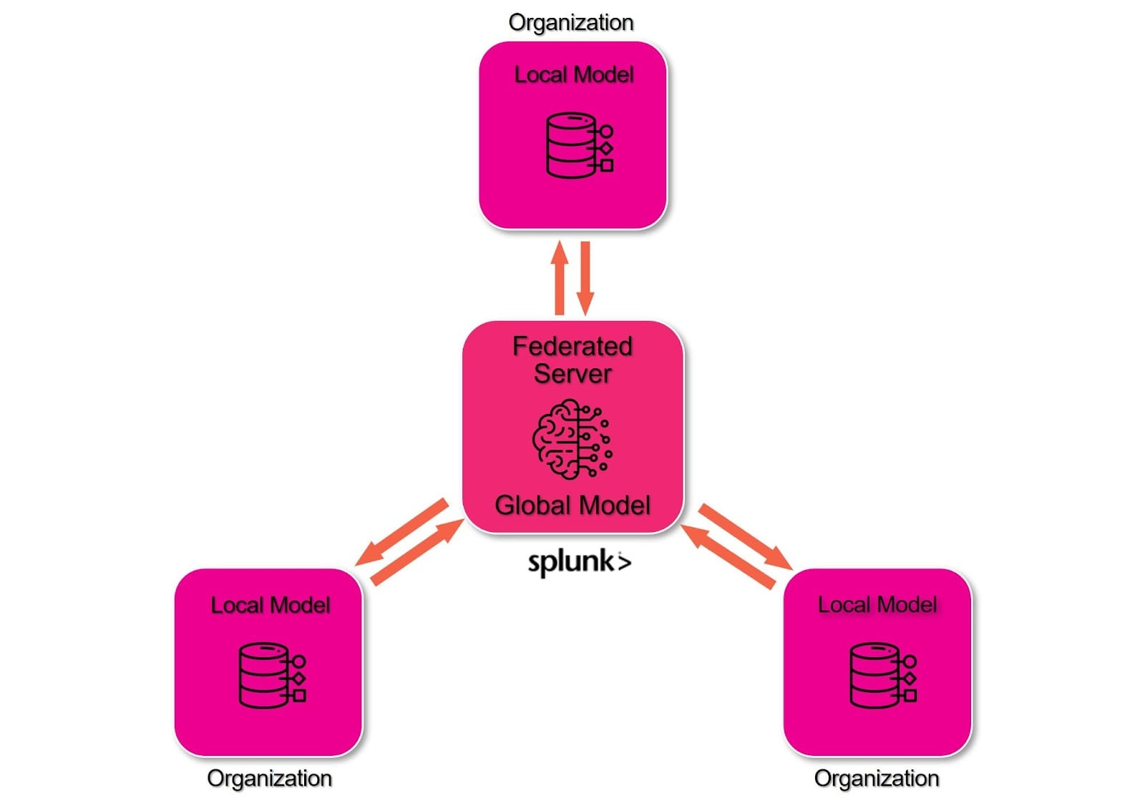
AI and Federated Learning
AI models can identify threats in real time with minimal human involvement (Sadhu et al., 2022).
Federated learning facilitates secure and decentralized model training without the need to share raw data.
However, challenges persist, including limited model transparency and significant computational requirements (Shree et al., 2024).

Slide 12
Implementation Challenges
Technical Issues
Cost Limitations
Communication Gaps
A significant challenge lies in the lack of interoperability between IoMT devices and healthcare platforms, which obstructs seamless integration and secure data exchange.
The high costs of implementation and maintenance hinder adoption, particularly within public hospitals and underfunded healthcare systems.
Inadequate coordination among IT teams, clinicians, and administrators results in delayed incident responses and undermines the effectiveness of overall cybersecurity strategies.

Slide 13
Critical Evaluation of Current Research
Numerous AI and blockchain solutions remain in the early stages of prototyping or experimental testing.
Research presents mixed findings regarding the scalability and practical effectiveness of these tools.
There's no global standard for securing IoMT, leading to inconsistent approaches.
The majority of existing research lacks validation within real-world clinical environments.

Slide 14
Research Gaps and Future Directions
There is an urgent need to establish global interoperability standards for IoMT systems..
Many AI solutions haven’t been tested in real-world healthcare settings.
Socioeconomic difficulties in impoverished regions are frequently ignored..
Future research should examine the long-term implications for security and ethics..

Slide 15
Strategic Recommendations
Promote the adoption of secure-by-design principles across all medical IoT devices..
1
Support international collaboration on IoMT cybersecurity policies.
2
Offer ongoing cybersecurity training for healthcare personnel..
3
Build public-private partnerships to fund and guide innovation.
4

Slide 16
Conclusion
IoMT greatly improves healthcare delivery; however, it also brings intricate cybersecurity risks.
Emerging technologies such as AI and blockchain present promising solutions, yet they encounter both technical and ethical challenges.
Ensuring a safe and secure IoMT ecosystem requires a collaborative, multi-stakeholder approach.

Slide 17
References
Algethami, S. A., & Alshamrani, S. S. (2024). A deep learning-based framework for strengthening cybersecurity in Internet of Health Things (IoHT) environments. Applied Sciences, 14(11), 4729. Available at: https://doi.org/10.3390/app14114729 (Accessed: 03 Oct 2025).
Alhaj, T. A., Abdulla, S. M., Iderss, M. A. E., Ali, A. A. A., Elhaj, F. A., Remli, M. A., & Gabralla, L. A. (2022). A survey: To govern, protect, and detect security principles on Internet of Medical Things (IoMT). IEEE Access, 10, 124777–124791. Available at: https://ieeexplore.ieee.org/document/9964214 (Accessed: 03 Oct 2025).
Bhukya, C. R., Thakur, P., Mudhivarthi, B. R., & Singh, G. (2023). Cybersecurity in Internet of Medical Vehicles: State-of-the-art analysis, research challenges and future perspectives. Sensors, 23(19), 8107. Available at: https://doi.org/10.3390/s23198107 (Accessed: 03 Oct 2025).
Bhushan, B., Kumar, A., Agarwal, A. K., Kumar, A., Bhattacharya, P., & Kumar, A. (2023). Towards a secure and sustainable Internet of Medical Things (IoMT): Requirements, design challenges, security techniques, and future trends. Sustainability, 15(7), 6177. Available at: https://doi.org/10.3390/su15076177 (Accessed: 03 Oct 2025).
Brown, S., Ruhwanya, Z., & Pekane, A. (2023). Factors influencing Internet of Medical Things (IoMT) cybersecurity protective behaviours among healthcare workers. In International Symposium on Human Aspects of Information Security and Assurance (pp. 432–444). Springer. Available at:https://doi.org/10.1007/978-3-031-38530-8_34 (Accessed: 03 Oct 2025).
Bughio, K. S., Cook, D. M., & Shah, S. A. A. (2024). Developing a novel ontology for cybersecurity in Internet of Medical Things-enabled remote patient monitoring. Sensors, 24(9), 2804. Available at: https://doi.org/10.3390/s24092804 (Accessed: 03 Oct 2025).
El-Saleh, A. A., Sheikh, A. M., Albreem, M. A., & Honnurvali, M. S. (2025). The Internet of Medical Things (IoMT): Opportunities and challenges. Wireless Networks, 31(1), 327–344. Available at: https://doi.org/10.1007/s11276-024-03764-8 (Accessed: 03 Oct 2025).

Slide 18
References
Fahim-Ul-Islam, M., Chakrabarty, A., Alam, M. G. R., & Maidin, S. S. (2025). A resource-efficient federated learning framework for intrusion detection in IoMT networks. IEEE Transactions on Consumer Electronics. Advance online publication. Available at:https://doi.org/10.1109/TCE.2025.3544885 (Accessed: 04 Oct 2025).
Guergov, S. (2022). Investigating E-Supply chain issues in Internet of Medical Things (IoMT): Evidence from the healthcare. International Journal of Computations, Information and Manufacturing (IJCIM), 2(2). Available at: https://doi.org/10.54489/ijcim.v2i2.110 (Accessed: 04 Oct 2025).
Manoharan, A., & Thathan, M. (2024). Enhanced IoMT security framework using group teaching optimized auto-encoder for intrusion detection. Scientific Reports, 14, Article 80581. Available at: https://doi.org/10.1038/s41598-024-80581-1 (Accessed: 04 Oct 2025).
Mushtaq, M., Shah, M. A., & Ghafoor, A. (2021). The Internet of Medical Things (IoMT): Security threats and issues affecting digital economy. In Competitive Advantage in the Digital Economy (CADE 2021) (Vol. 2021, pp. 137–142). IET. Available at: https://doi.org/10.3390/fi17030107 (Accessed: 04 Oct 2025).
Papaioannou, M., Karageorgou, M., Mantas, G., Sucasas, V., Essop, I., Rodriguez, J., & Lymberopoulos, D. (2022). A survey on security threats and countermeasures in Internet of Medical Things (IoMT). Transactions on Emerging Telecommunications Technologies, 33(6), e4049. Available at: https://doi.org/10.1002/ett.4049 (Accessed: 04 Oct 2025).
Sadhu, P. K., Yanambaka, V. P., Abdelgawad, A., & Yelamarthi, K. (2022). Prospect of Internet of Medical Things: A review on security requirements and solutions. Sensors, 22(15), 5517. Available at: https://doi.org/10.3390/s22155517 (Accessed: 04 Oct 2025).
Shafik, W. (2025). Artificial Intelligence-assisted Internet of Medical Things (AIoMTs) in sustainable healthcare ecosystem. In Sustainable Healthcare Systems (pp. 75–101). Available at: https://doi.org/10.1002/9781394287024.ch3 (Accessed: 04 Oct 2025).

Slide 19
References
Ree, S., Zhou, C., & Barati, M. (2024). Data protection in Internet of Medical Things using blockchain and secret sharing method. Journal of Supercomputing, 80, 5108–5135. Available at: https://doi.org/10.1007/s11227-023-05657-7 (Accessed: 04 Oct 2025).
Svandova, K., & Smutny, Z. (2024). Internet of Medical Things security frameworks for risk assessment and management: A scoping review. Journal of Multidisciplinary Healthcare, 2281–2301. Available at: https://doi.org/10.2147/JMDH.S459987 (Accessed: 04 Oct 2025).
Tarikere, S., Donner, I., & Woods, D. (2021). Diagnosing a healthcare cybersecurity crisis: The impact of IoMT advancements and 5G. Business Horizons, 64(6), 799–807. Available at: https://doi.org/10.1016/j.bushor.2021.07.015 (Accessed: 04 Oct 2025).
Thomasian, N. M., & Adashi, E. Y. (2021). Cybersecurity in the Internet of Medical Things. Health Policy and Technology, 10(3), 100549. Available at: https://doi.org/10.1016/j.hlpt.2021.100549 (Accessed: 04 Oct 2025).

